Slide 1
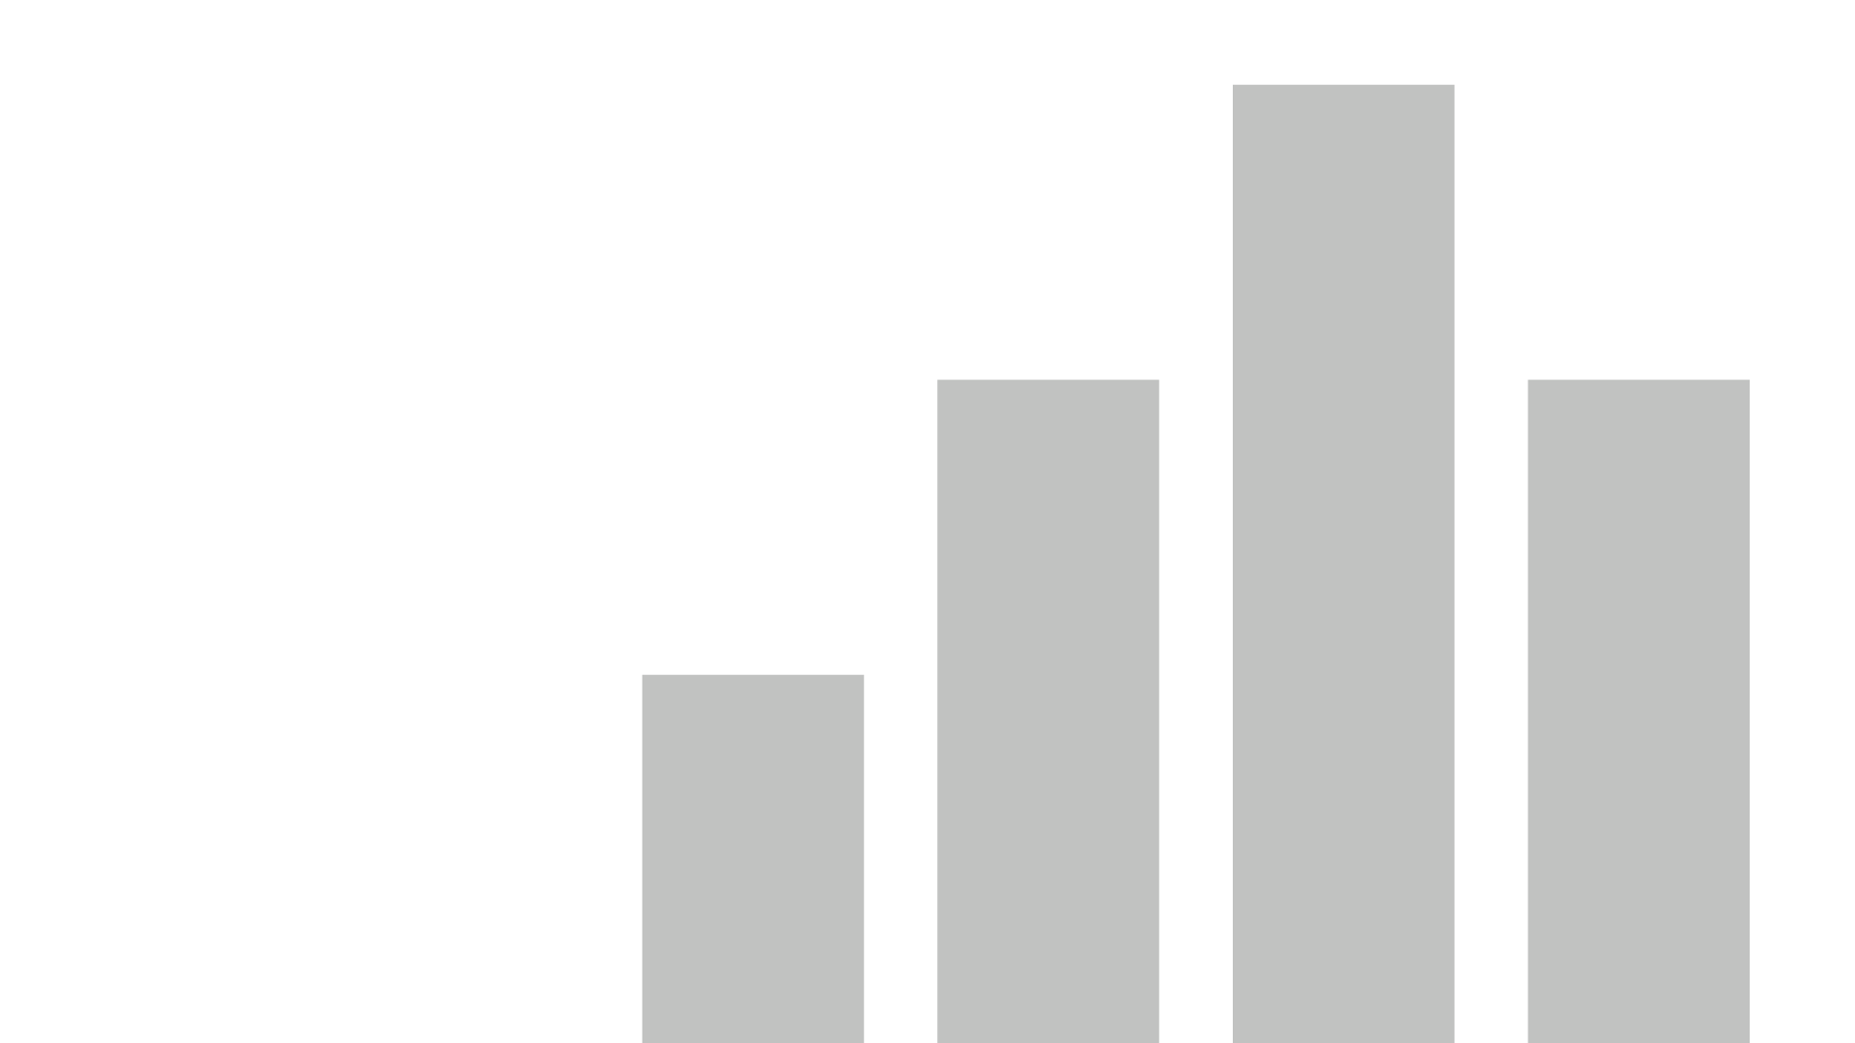


The SF-CRIME DATA VISUALIZATION
View in Power BI
Last data refresh:
7/24/2020 5:57:37 PM UTC
Downloaded at:
7/24/2020 8:03:48 PM UTC

Slide 2
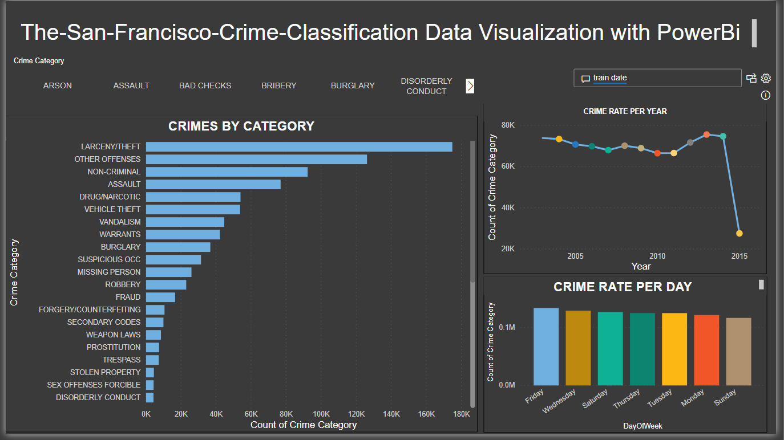
CRIME RATE PER YEAR
CRIMES BY CATEGORY
CRIME RATE PER DAY

Slide 3
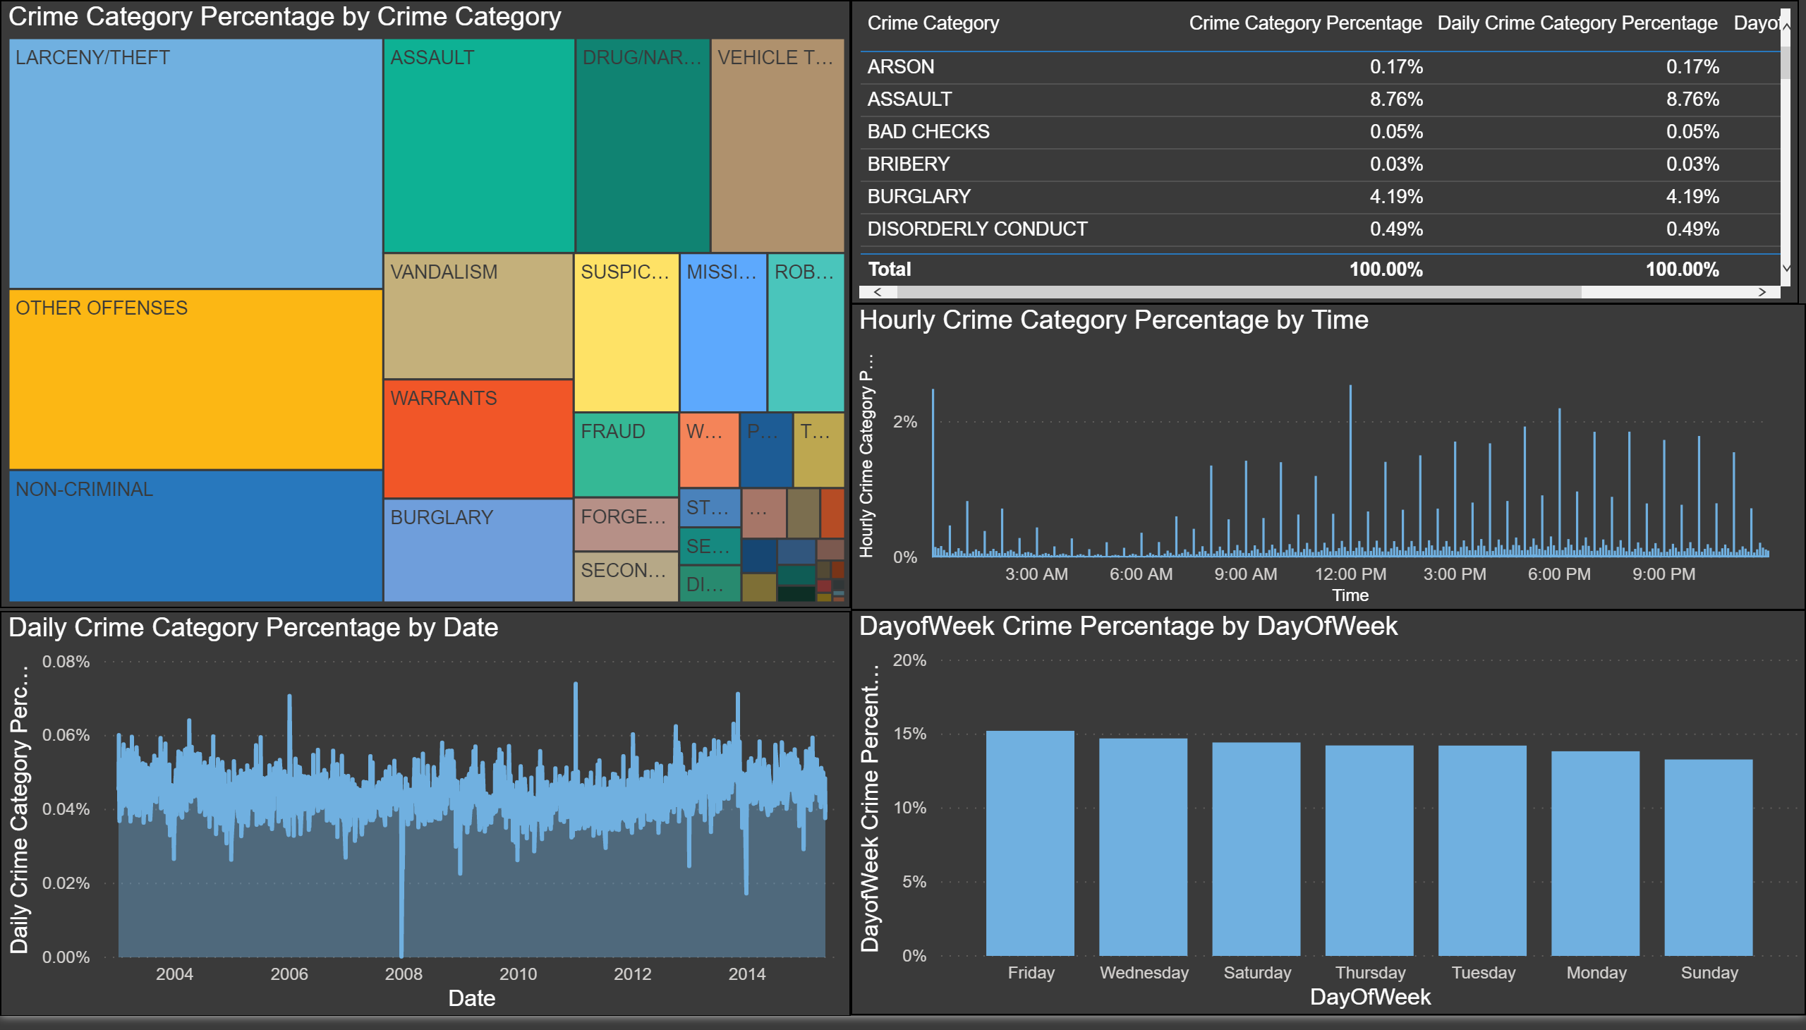
CRIME CLASSIFICATION
CRIME PERCENTAGE BY THE HOUR
DAILY CRIME PERCENTAGE
WEEKLY CRIME PERCENTAGE

Slide 4
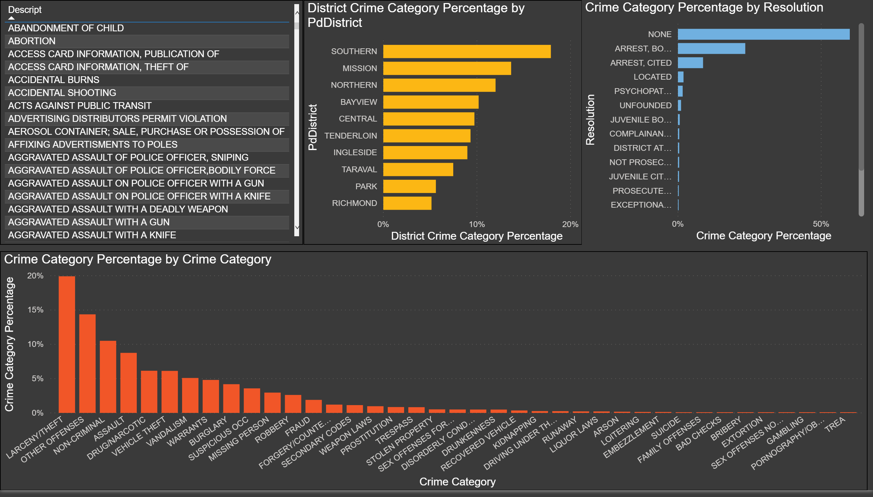
PERCENTAGE OF CRIME BY DISCRICT
CRIME RESOLUTION PERCENTAGE
TOTAL CRIME CATEGORY PERCENTAGE

Slide 5
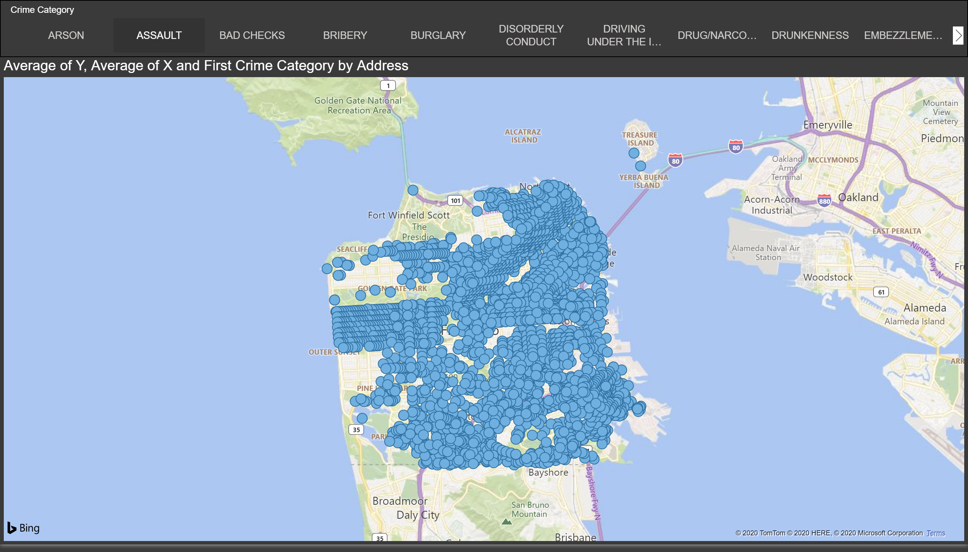
DETAILED LOCATION OF EACH CRIMES

